Slide 1
What’s RAG got to do with it?
With apologies to the late, great Tina Turner. Rich Robbins

Slide 2
What is generative AI (and why do we care)?
Hallmarks of generative artificial intelligence
It generates new information
It works with concepts without requiring additional training
Lawyers work with words in very nuanced ways
Systems that offer concept based (semantic) search with plain language interfaces that generate high quality text are exceptionally valuable to lawyers

Slide 3
Models models everywhere, but which one is for me?
Foundation models
A foundation model is a type of large-scale model that is trained on a broad dataset from diverse sources, enabling it to learn a wide range of tasks without being specifically trained for them.
Task-specific models
These models are designed and trained for a specific task or a narrow set of tasks. Unlike foundation models, they may not perform well outside their intended use case.

Slide 4
Why not use a foundation model and call it a day?
Model hallucination
Hallucination is where a model generates incorrect, fabricated, or nonsensical information that is not supported by the input data or real-world knowledge.
It is most often observed in generative foundation models like ChatGPT, Claude, Gemini, Llama and Mistral during tasks like text generation, summarization, or question answering. (The tasks we care about the most.)
Vast but still limited knowledge
Foundation models reflect a vast amount of information but not private information and not information from after the models are trained. They don’t know the latest Taylor Swift news or any private information our clients care about. And even when they answer, they are not able to explain themselves.

Slide 5
But all is not lost.
A strategy
Supply the model with the information we want it to use. Think of it as an open book test.
Tell the model that when it comes to facts, it should only use the information we supply and when it answers, it must cite the sources it used.
Remind the model that if the answer cannot be found in what we supply it should not answer the question.
So, we cut down on hallucination by limiting the ability of the model to fabricate information and we can tell it about the latest Taylor Swift news too.
We call this approach Retrieval Augmented Generation.

Slide 6
Wait a minute, I must supply the model with everything?
The context window problem
Every model has a fixed input size known as its context window size. It’s measured in tokens, which you can think of as syllables.
Some of the most recent models have huge context windows, but our data collections are even larger.
And even if we could drop everything into the context window, that would be slow and expensive (most of the time we pay by the token).
So, we look to a special database known as a vector database to isolate a small collection of information that we expect contains that answer to our question and we give that small collection to the generative model instead of everything.

Slide 7
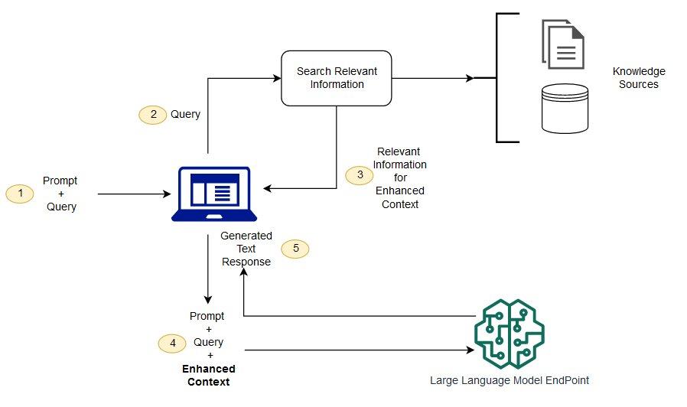
RAG Architecture
Retrieval Augmented Generation (RAG) - Amazon SageMaker

Slide 8
Why that name?
Retrieval Augment Generation
We retrieve information from data sources that the model does not know about to augment the ability of the model to generate responses to queries we give it.

Slide 9
I thought we were adding Q&A to Epiq Discovery. Talk about that!
Generative AI and Q&A is what RAG is all about
When vendors talk about using generative artificial intelligence to let people ask questions about a collection of documents, whether it is corporate policies, user guides, or a corpus of documents in an eDiscovery tool, you should expect that under the hood is a RAG system.
As we look to add a new powerful question answering capability to Epiq Discovery, it will be built using the RAG approach.
What I have described is known as naïve RAG, there are lots of other things we can do to enhance the system, but talking about those is beyond the scope of this presentation.

Slide 10
Can I ask it anything? Nope. Why not?
Building intuition for using RAG systems
RAG systems typically appear with a plain English interface, you ask a question and get an answer. You should get citations or links to the relevant documents.
People can easily ask questions that the system will not handle gracefully.
Remember our architecture. We go to a database and pick up a small number of documents from the database that may contain an answer.
If you ask a question that can’t be answered that way, the system will fail.
If the topic is not covered in the document collection, you are out of luck. If the answer is not on the pages of one of the documents, you are out of luck. If the answer requires looking at many examples, you are out of luck. A good system will defer when it cannot answer or coordinate with another one. Set your expectations accordingly.

Slide 11

Questions/Feedback

